Slide 1
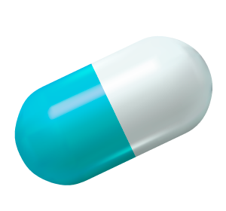



Integrative Approach to Cardiovascular Health Management
2023-24-015

Slide 2




Team Members
Amaraweera O. G.
Dewantha A. A. A. R. S.​ (Group Leader)
Jayasekara J.M.P.N.K
Lakshan J. A. T.
Supervisor : Dr. Kapila Dissanayaka​
Co-Supervisor : Ms. Bhagyanie Chathurika​
External Supervisor : Dr Susith Athukorala
IT20616588
Department of Software Engineering
IT20618186
Department of Information Technology
IT20623418
Department of Software Engineering
IT20642150
Department of Information Technology

Slide 3
Introduction
Heart disease remains a global challenge, stressing the need for prevention and early intervention.
Our study focuses on predictive analytics, machine learning, and mobile technology for comprehensive cardiovascular health management.
Key aspects include risk prediction, dietary guidance, medication access, and entering medicine management .
This integrated approach aims to improve patient outcomes and revolutionize healthcare delivery.

Slide 4
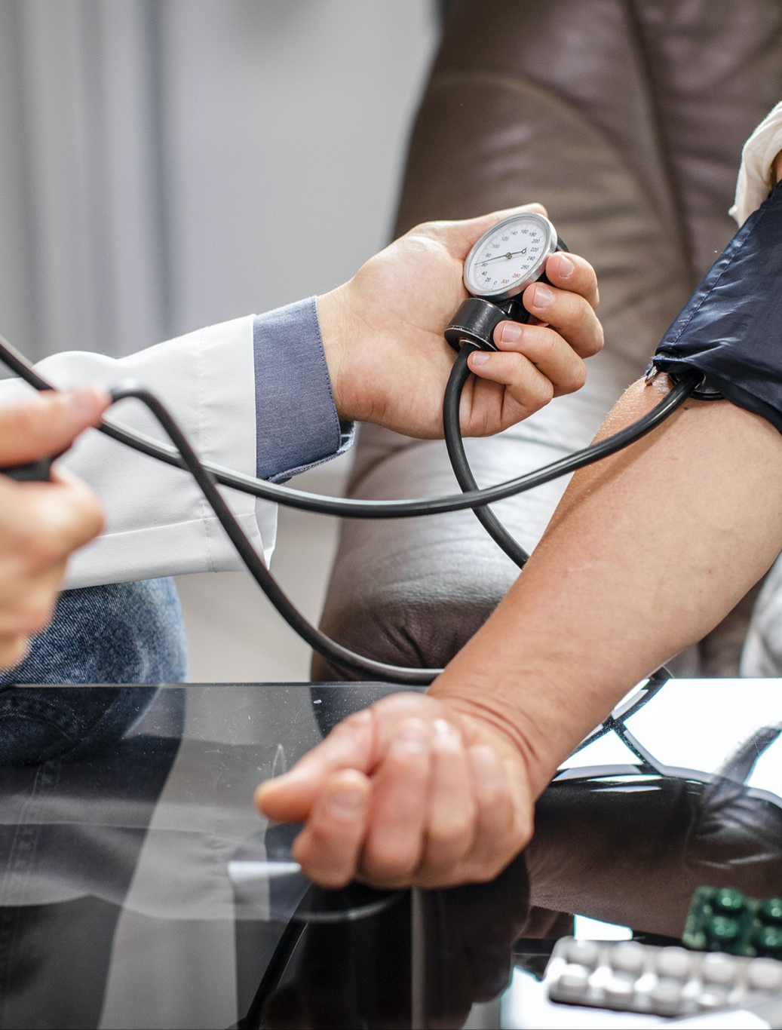
Overall Project Description
Comprehensive study addressing key aspects of cardiovascular health management.
Utilizes predictive analytics, machine learning, and mobile technology for holistic solutions.
Focus areas include risk prediction, dietary guidance, medication access, and secure data management.
Innovations include predictive models for heart attack likelihood, personalized dietary recommendations, and efficient pharmacy location services.
Aim is to revolutionize healthcare delivery and improve patient outcomes.

Slide 5

Research Objectives
Predicting Heart Attack Probability
Healthy Dietary Guidance
ECG Automated Analysis and Generated graph chart for identify risk level
Pharmacies Indexing Based On Patient's Reviews

Slide 6

Research Questions
How can predictive analytics and machine learning algorithms enhance cardiovascular risk prediction?
What methods can be employed to provide Healthy Dietary Guidance using image recognition technology?
How can machine learning algorithms assist in locating nearby pharmacies for efficient medication access?
How does the integrated approach of predictive analytics, machine learning, and mobile technology revolutionize cardiovascular health management?

Slide 7

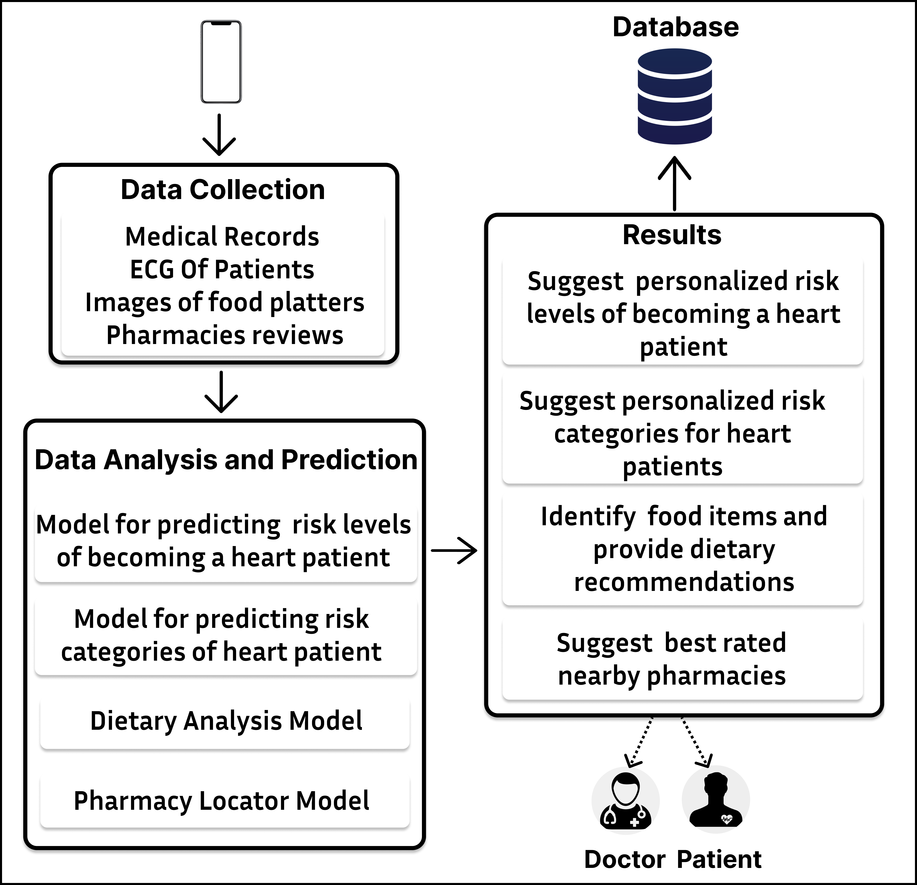
Overall System Diagram

Slide 8
Dewantha A.A.A.R.S
IT20618186
BSc (Hons) in Information Technology
Specializing in Information Technology
IT20618186 | DEWANTHA A.A.A.R.S | 2023-24-015

Slide 9

Background
Through the mobile application, both the patient and the doctor are provided with a graphical chart to monitor their progress according to the treatment he or she has received, the patient's current condition, and the risks condition that may occur in the future.
IT20618186 | DEWANTHA A.A.A.R.S | 2023-24-015

Slide 10
Research Problem
Specific Objective
A patient should meet with a doctor to check the ECG medical records. There is no system designed for the convenience of the doctor and the patient.
Develop an automated system that utilizes machine learning algorithms to analyze ECG medical records and generated graph chart for descriptive risk conditions of patients
IT20618186 | DEWANTHA A.A.A.R.S | 2023-24-015

Slide 11

Possible solution
Develop an automated system that utilizes machine learning algorithms to analyze ECG medical records, predict future heart disease-related issues, and generate a graph chart for visual representation of the patient's current and predicted future status.
IT20618186 | DEWANTHA A.A.A.R.S | 2023-24-015

Slide 12
System Diagram
IT20618186 | DEWANTHA A.A.A.R.S | 2023-24-015

Slide 13
Methodology
2
4
1
3
Data
Collection
Model training
Model
Evaluation
Mobile App Development
Future Risk
Level with generate chart
Data Preprocessing
Feature Extraction
IT20618186 | DEWANTHA A.A.A.R.S | 2023-24-015

Slide 14
Developed Solution
ECG automated analysis:
● preprocessing the ECG data to remove noise and artifacts using KNN machine learning algorithm
Generate informative chart:
●Develop a user-friendly interface for generating graph chart and to the doctor and patient, to take care of patient's risk level.
●Create Firebase database for store checked patient's risk condition.
Benefit:
●This approach helps heart patients to recognize their risk level and act accordingly.
IT20618186 | DEWANTHA A.A.A.R.S | 2023-24-015

Slide 15
Why Can't Use CNN ?
https://colab.research.google.com/drive/1FMrIpfuZQN99fnIJhDUPTrfl4-Tcrg2w?usp=drive_link

Slide 16
KNN APPROACH
https://drive.google.com/file/d/19kzp64ZaBj--zfFuDvPcj0krlV5uUux6/view?usp=sharing

Slide 17


Result & Discussion
Developed KNN model to predict heart attack probability
Automated analysis ECG records into four conditions.
Normal Heartbeat
Abnormal Heartbeat
Patient that have history of MI
Myocardial Infraction
Generating a graph chart and to the doctor and the patient, to take care of patient's risk.
Create No-SQL database for save predicted Risk condition.
IT20618186 | DEWANTHA A.A.A.R.S | 2023-24-015

Slide 18
Generate Graph
The normal person category was grouped as low risk (represented by 0),
The abnormal heartbeat category as medium risk (represented by 1), and
The myocardial infraction and history of myocardial infraction categories were selected as high risk (represented by 2).
Accordingly, a graph generated by the mobile application is shown below with Risk Level in y-axis (vertical) and Dates in x- axis (horizontal).

Slide 19


Conclusion
Develop an automated system that utilizes machine learning algorithms to analyze ECG medical records, predict future heart disease-related issues, and generate a graph chart for visual representation of the patient's current and predicted future status.
IT20618186 | DEWANTHA A.A.A.R.S | 2023-24-015

Slide 20




Tools
Development – Python, Flutter
Version Controlling – GitHub.
Connector – Ngrok
Technologies
Python Libraries
Google Colab
Android Studio
Algorithm
k-nearest neighbors (KNN)
Support vector Machine (SVM)
IT20618186 | DEWANTHA A.A.A.R.S | 2023-24-015

Slide 21
Amaraweera O.G
IT20616588
BSc (Hons) in Information Technology
Specializing in Software Engineering
IT20616588 | Amaraweera O.G | 2023-24-015

Slide 22

Background
The healthcare industry has witnessed a significant surge in utilizing data mining and machine learning techniques for detecting foods according to the patient's condition.
For most of the non-communicable diseases are born within due to the unhealthy dietary habits.
IT20616588 | Amaraweera O.G | 2023-24-015

Slide 23
Research Problem
Specific Objective
Developing a tool for patients to get to know whether their dietary habits are good or bad.
Training a model using YOLO to detect the objects (food items) in the meal, and giving tips whether they are good or bad.
IT20616588 | Amaraweera O.G | 2023-24-015

Slide 24
System Diagram
IT20616588 | Amaraweera O.G | 2023-24-015

Slide 25
Possible solution
Develop a user-friendly mobile application that integrates YOLOv5 model to identify food items and giving the calory amount, and helpful tips for the patient according to his condition.
IT20616588 | Amaraweera O.G | 2023-24-015

Slide 26
Methodology
2
4
1
3
Data
Collection
Model Development
Model
Training
Future Risk
Stratification
Mobile App Development
Data Preprocessing
IT20616588 | Amaraweera O.G | 2023-24-015

Slide 27
Tools
Development – Python, Flutter , Dart
Version Controlling – GitHub.
Technologies
Python Libraries
Google colab
Android Studio
Algorithm
YOLOv5
IT20616588 | Amaraweera O.G | 2023-24-015

Slide 28
Developed Solution
User-friendly Interface
Intuitive design enables easy data input for users of all backgrounds.
Seamless navigation enhances user experience and accessibility.
YOLOv5 Model
Detecting images and identifying the food items in the meal.
Model optimized for accuracy and reliability, ensuring dependable risk assessment.
Risk Stratification
Identifying the food and the amount of the calories it has and giving reliable tips according to the patient's condition.
IT20616588 | Amaraweera O.G | 2023-24-015

Slide 29
Result & Discussion
Developed YOLOv5 model to detect images.
Process the images and identify them correctly when user input an image.
Provided relevant instructions based on the patient's condition.
Designed user-friendly interface for easy understanding and navigation.
IT20616588 | Amaraweera O.G | 2023-24-015

Slide 30
Conclusion
Our developed mobile application offers a reliable, accessible, and user-friendly solution for detecting food and identifying whether they are good or bad for the patient using image training technologies.
IT20616588 | Amaraweera O.G | 2023-24-015

Slide 31
Jayasekara J.M.P.N.K
IT20623418
BSc (Hons) in Information Technology
Specializing in Software Engineering
IT20623418 | Jayasekara J.M.P.N.K | 2023-24-015

Slide 32

Background
The healthcare industry has witnessed a significant surge in utilizing data mining and machine learning techniques for predicting cardiovascular diseases.
Heart disease remains a leading cause of mortality globally, prompting extensive research into early detection and prevention strategies.
IT20623418 | Jayasekara J.M.P.N.K | 2023-24-015

Slide 33
Research Problem
Specific Objective
Predicting heart attack possibility with sufficient accuracy and clarity for effective risk communication remains a challenge in cardiovascular risk management.
Develop a logistic regression model to predict heart attack possibility and stratify risk levels into five categories (Dark red ,Red, Orange, Yellow, Green) based on WHO guidelines, ensuring accuracy, clarity, and usability for effective cardiovascular risk management.
IT20623418 | Jayasekara J.M.P.N.K | 2023-24-015

Slide 34
System
IT20623418 | Jayasekara J.M.P.N.K | 2023-24-015

Slide 35
Possible solution
Develop a user-friendly mobile application that integrates the Logistic regression model for predicting heart attack possibility and stratifying risk levels into five categories (Red, Orange, Yellow, Green , White) based on WHO guidelines.
IT20623418 | Jayasekara J.M.P.N.K | 2023-24-015

Slide 36
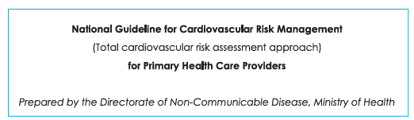
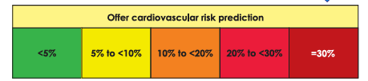
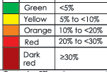
Cardiovascular Risk Assessment Overview
Diagram sourced from "WHO National Guidelines for Cardiovascular Risk Management."
Illustrates the process of CVD risk assessment.
Risk categorized into 5 levels for precise determination by patients.
IT20623418 | Jayasekara J.M.P.N.K | 2023-24-015

Slide 37
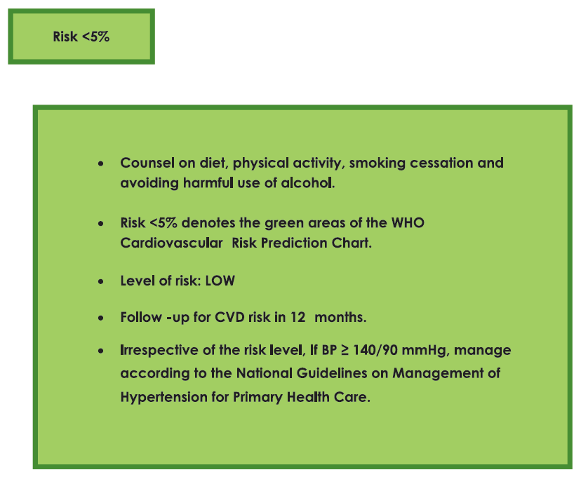
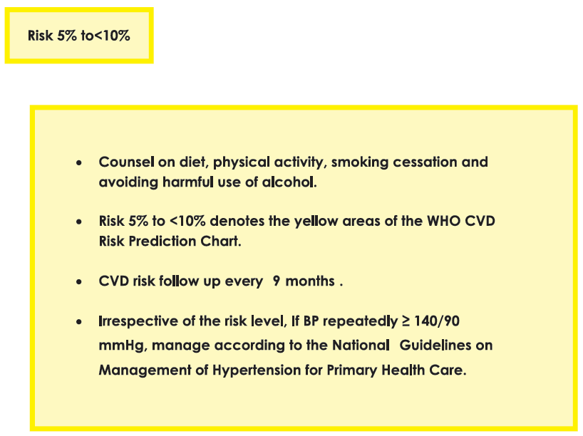
Provide cardiovascular risk management as per risk status
Assess patient's risk level.
Tailor instructions based on WHO National Guidelines.
Provide relevant education according to patient's current condition."
IT20623418 | Jayasekara J.M.P.N.K | 2023-24-015

Slide 38
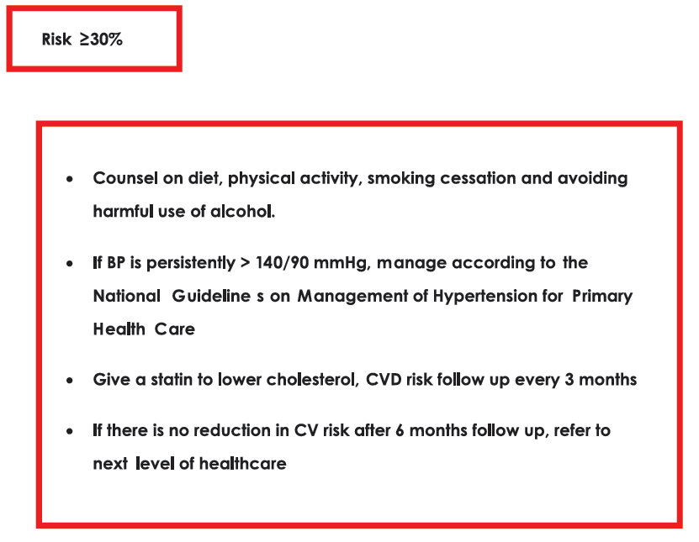
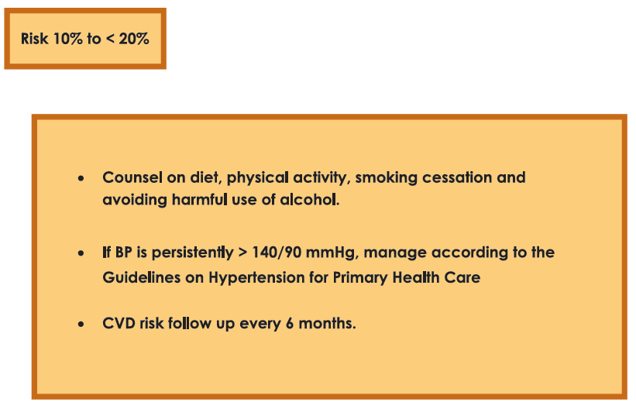
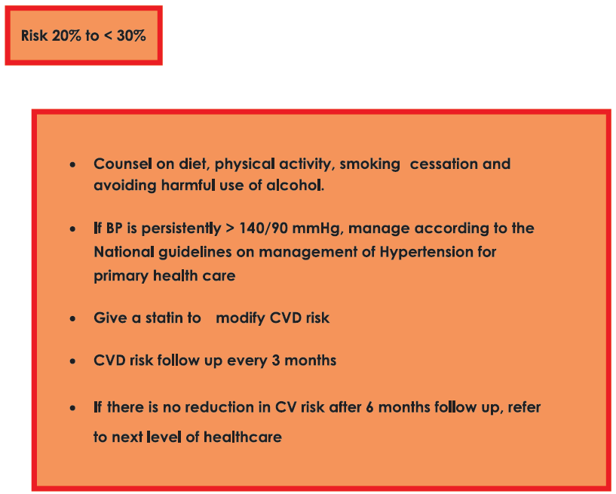
IT20623418 | Jayasekara J.M.P.N.K | 2023-24-015

Slide 39
Tools
Development – Python, Flutter , Dart
Version Controlling – GitHub.
Technologies
Python Libraries
Google colab
Android Studio
Algorithm
Logistic Regression
IT20623418 | Jayasekara J.M.P.N.K | 2023-24-015

Slide 40
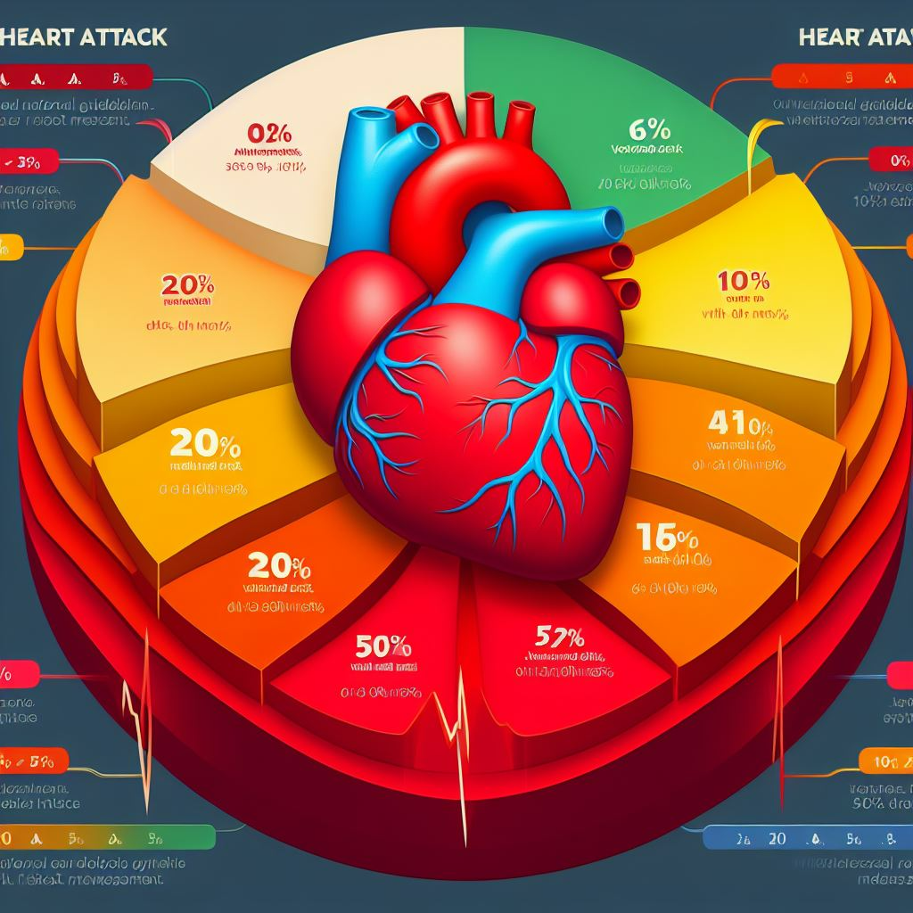
Developed Solution
User-friendly Interface
Intuitive design enables easy data input and risk assessment for users of all backgrounds.
Seamless navigation enhances user experience and accessibility.
Logistic Regression Model
Implemented logistic regression model to predicts heart attack probability based on user-entered data.
Model optimized for accuracy and reliability, ensuring dependable risk assessment.
Risk Stratification
Predicted probabilities stratified into five risk levels (Dark Red, Red Orange, Yellow, Green ) following WHO National Guideline for cardiovascular risk management.
Color-coded indicators provide clear risk visualization for users.
IT20623418 | Jayasekara J.M.P.N.K | 2023-24-015

Slide 41
Result & Discussion
Developed logistic regression model with 85% accuracy to predict heart attack probability.
Stratified predicted probabilities into five risk levels by considering WHO National Guidelines
Dark Red: Higher Risk
Red: High Risk
Orange: Elevated Risk
Yellow: Moderate Risk
Green: Low Risk
White: No Risk
Provided relevant instructions based on risk levels by considering WHO National Guidelines
Designed user-friendly interface for easy understanding and navigation.
IT20623418 | Jayasekara J.M.P.N.K | 2023-24-015

Slide 42
Conclusion
Our developed mobile application offers a reliable, accessible, and user-friendly solution for heart attack risk assessment, leveraging logistic regression to provide accurate predictions and intuitive risk stratification.
IT20623418 | Jayasekara J.M.P.N.K | 2023-24-015

Slide 43
LAKSHAN J.A.T.
IT20642150
BSc (Hons) in Information Technology
Specializing in Information Technology
IT20642150 | LAKSHAN J.A.T. | TMP-2023-24-015

Slide 44
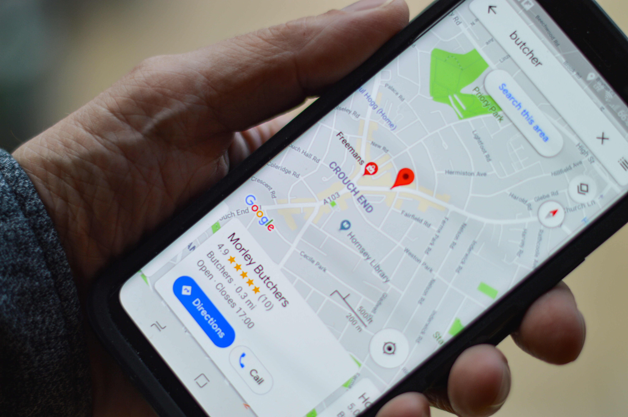
Background
Optimizing the process of finding nearby pharmacies and accessing relevant information is essential for improving healthcare delivery. This includes factors like user location, distance, medicine availability, and pharmacy reputation.
Machine learning techniques, like sentiment analysis, can be valuable tools for analyzing user reviews and extracting valuable insights on pharmacy services.
IT20642150 | LAKSHAN J.A.T. | TMP-2023-24-015

Slide 45

Research Problem
Specific Objectives
To develop a streamlined method that utilizes Android technology and Machine Learning to identify the best rated nearby pharmacies based on the user's location, and customer ratings, ultimately enhancing the accessibility and interaction with healthcare services, particularly pharmacies
Google Maps API to pinpoint a user's location and identify nearby pharmacies. This improves healthcare navigation by helping users efficiently locate pharmacies in their area
Use Machine learning techniques to analyze pharmacy reviews and predict ratings. This helps users find pharmacies with better service.
IT20642150 | LAKSHAN J.A.T. | TMP-2023-24-015

Slide 46
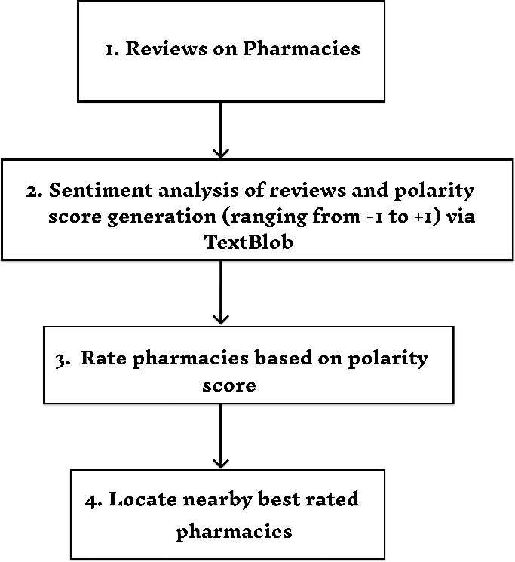
System Diagram
IT20642150 | LAKSHAN J.A.T. | TMP-2023-24-015

Slide 47
Possible solution
The application provides a streamlined and efficient way for users to locate pharmacies, assess their reputation through predicted ratings, and ensure medicine availability
IT20642150 | LAKSHAN J.A.T. | TMP-2023-24-015

Slide 48
Methodology
2
4
1
3
Token ID Generation and User’s Location Detection
Locating nearby
Pharmacies
Adding Reviews
By the User
Predicting star ratings of Pharmacies by reviews
Mobile App Development
Aim to develop and deploy a reliable and user-friendly mobile application for to find the best rated nearby pharmacies, view predicted ratings based on sentiment analysis
IT20642150 | LAKSHAN J.A.T. | TMP-2023-24-015

Slide 49
Tools
Development – Python, Flutter , Dart
Version Controlling – GitHub.
Technologies
Python Libraries (TextBlob)
Google colab
Android Studio
Algorithm
Sentiment Analysis technique(NLP)
IT20642150 | LAKSHAN J.A.T. | TMP-2023-24-015

Slide 50

Developed Solution
User Location:
● The app displays the user's current location on a Google map.
Pharmacies Recommendation:
●Upon user request, the app recommends nearby Pharmacies
●The sentiment analysis algorithm, a classification algorithm, predicts ratings for the reviews. Pharmacies with higher predicted ratings are displayed first.
Benefit:
●This approach saves time by recommending highly-rated Pharmacies based on user location and processed reviews.
IT20642150 | LAKSHAN J.A.T. | TMP-2023-24-015

Slide 51
Result & Discussion
Displays the user’s current location in the map.
Displays the list of Pharmacies on user’s request along with the ratings predicted by the reviews
Displays those Pharmacies in the list, marked on the map from where the user can direct to Google Maps for directions to the nearby pharmacy
To display the higher rated Pharmacies.
IT20642150 | LAKSHAN J.A.T. | TMP-2023-24-015

Slide 52
Conclusion
Our developed mobile application offers a reliable, accessible, and user-friendly solution for finding the best rated nearby pharmacies
IT20642150 | LAKSHAN J.A.T. | TMP-2023-24-015

Slide 53

Thanks!

